Slide 1

IL TRATTAMENTO FARMACOLOGICO DELL’OBESITA’: STORIA E STATO DELL’ARTE
Roberta Lupoli
Dipartimento di Medicina Molecolare e Biotecnologie Mediche
Università degli Studi di Napoli Federico II

Slide 2
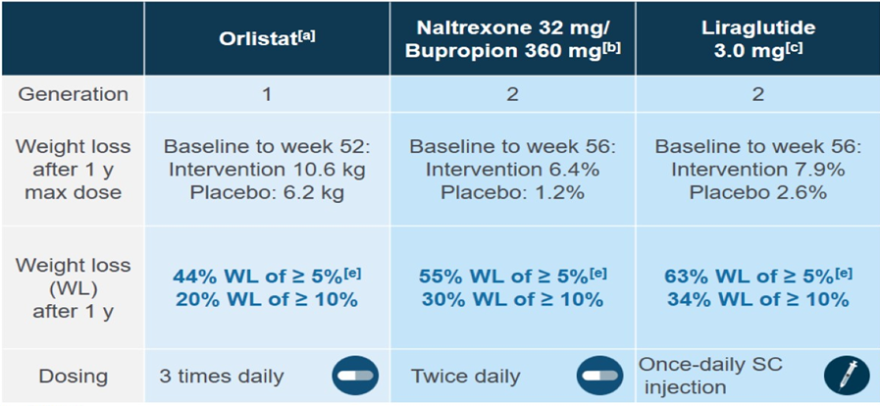
Terapia farmacologica dell'obesità…fino a ieri

Slide 3
Terapia farmacologica dell'obesità…oggi
SEMAGLUTIDE 2.4 mg
Direct activation of the hindbrain (AP/NTS)
Direct acess to lateral septum
Reduced appetite & cravings, improved control of eating
Reduced
energy intake
-
PB
Septum
+
AP
Semaglutide
NTS
HYP
Direct activation of the hypothalamus (HYP)
Other metabolic & CV effects
Reduced body weight
Modified from Campos et al. Cell metabolism 2016;23(5):811-820
AP/NTS, area postrema/nucleus of the solitary tract; PB, parabrachial nucleus; HYP, hypothalamus
Friedrichsen et al. Diabetes Obes Metab 2021;23:754–62
Merchenthaler et al. J Comp Neurol 1999;403:261–80
Baggio et al. Gastroenterology 2007;132:2131–57
Drucker and Nauck. Lancet 2006;368:1696–705

Slide 4
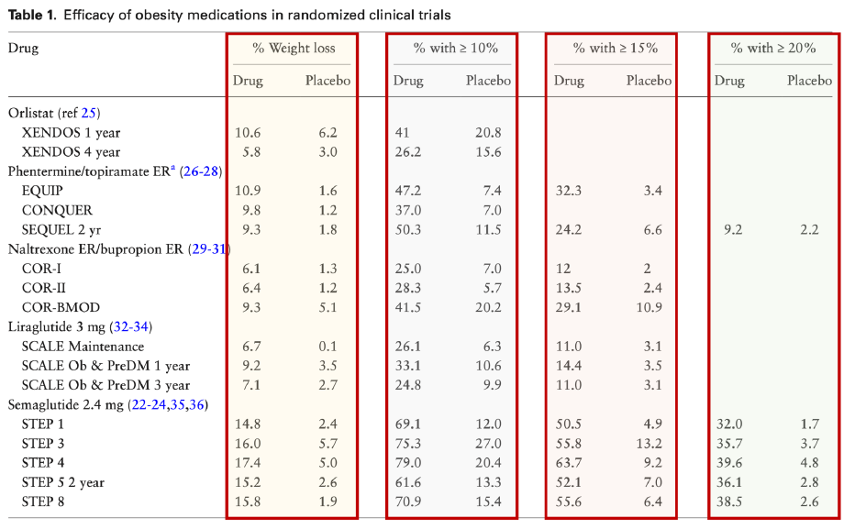
Efficacy of obesity medications in randomized clinical trials
Garvey et al. JCEM 2022

Slide 5
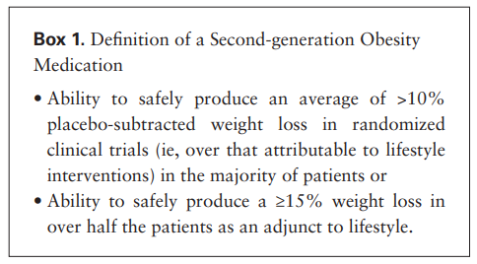
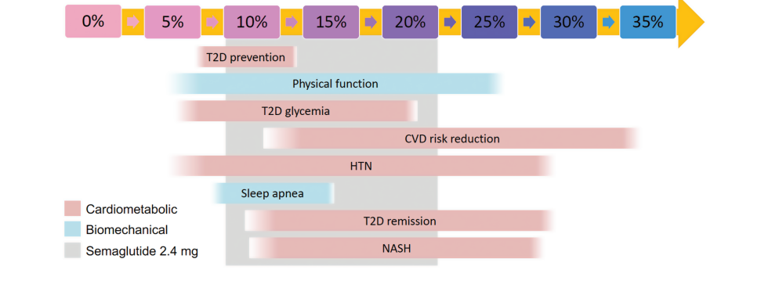
SEMAGLUTIDE 2.4 mg: un farmaco di seconda generazione
↑ Efficacia rispetto ai farmaci precedenti approvati per il trattamento dell’obesità (Perdita > 10% del peso iniziale)
↑ Benefici associati al % di calo ponderale
Garvey et al. JCEM 2022

Slide 6
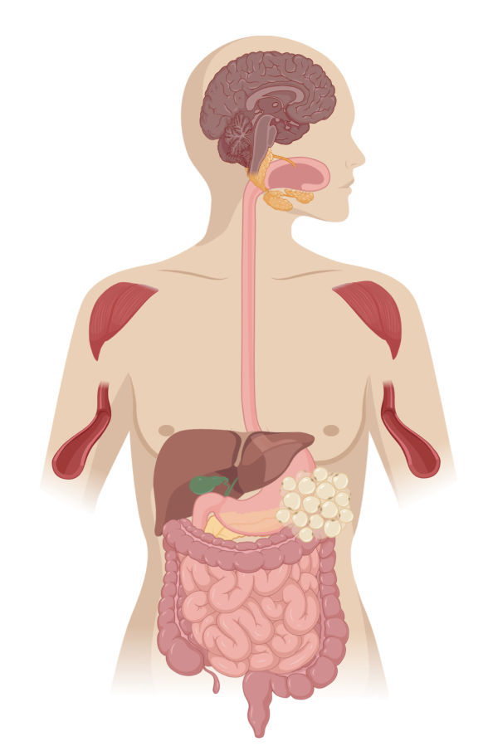
Tirzepatide: a GIP/GLP-1 receptor dual agonist
GLP-1 Receptor Agonism
GIP Receptor Agonism
Central Nervous System
Central Nervous System
↑ Satiety
↓ Food Intake
↑ Nausea
↓ Body Weight
Central Nervous System
↓ Food intake
↓ Nausea
↓ Body weight
Pancreas
↑ Insulin
↓ Glucagon
Pancreas
↑ Insulin
↑ Glucagon
Stomach
↓ Gastric Emptying
Skeletal Muscle
Subcutaneous White Adipose Tissue
↑ Insulin Sensitivity
↑ Lipid Buffering Capacity
↑ Blood Flow
↑ Storage Capacity
↓ Proinflammatory Immune Cell Infiltration
Systemic
↓ Hyperglycemia
Liver
Stomach
Liver
↑ Insulin Sensitivity
↓ Hepatic Glucose Production
↓ Ectopic Lipid Accumulation
Pancreas
Systemic
↓ Hyperglycemia, Dietary Triglyceride
Subcutaneous White Adipose Tissue
Skeletal Muscle
↑ Insulin Sensitivity
↑ Metabolic Flexibility
↓ Ectopic Lipid Accumulation
GLP-1 Receptor Agonism
GIP Receptor Agonism
Indirect Action

Slide 7
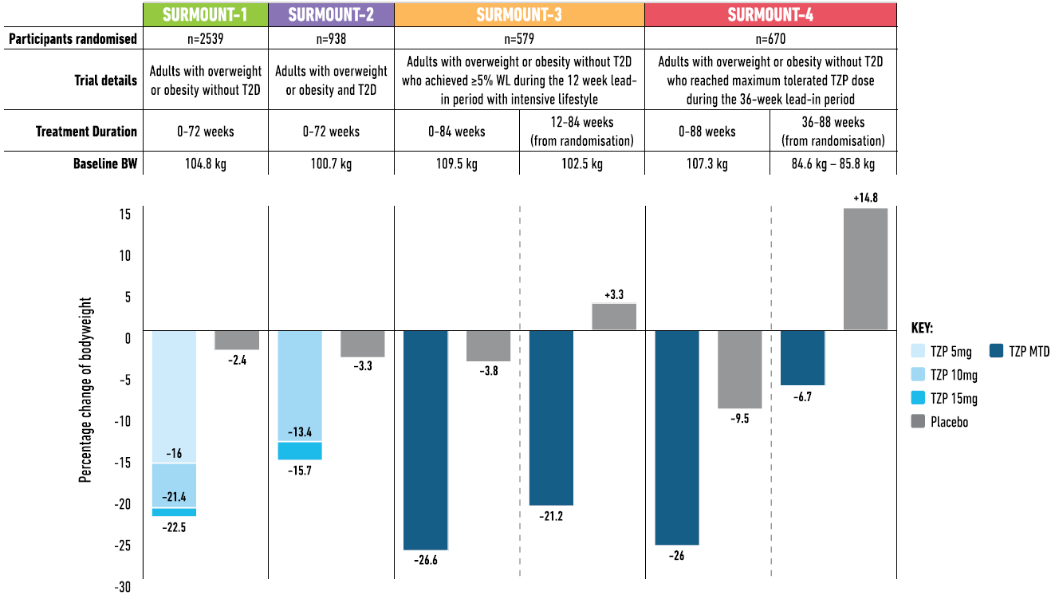
Change in bodyweight with different doses of tirzepatide vs placebo in SURMOUNT 1-4 studies

Slide 8


Quali novità ci riserva il futuro?

Slide 9

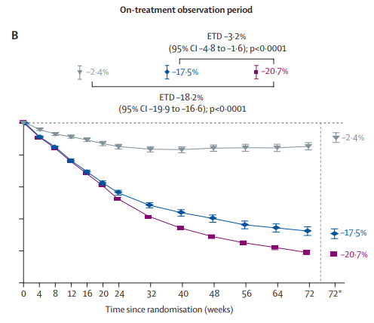
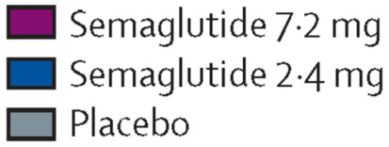
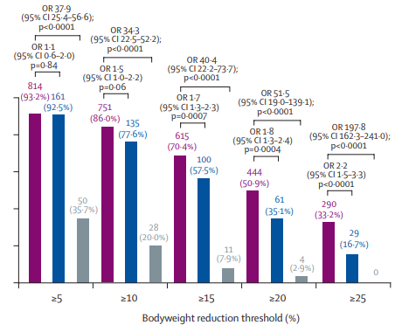
Practicalities of Prescribing Oral, Long-Acting GLP-1 RAs
Lingvay I et al. Lancet Diabetes Endocrinol. 2025 Sep 14:S2213-8587(25)00225-6.

Slide 10
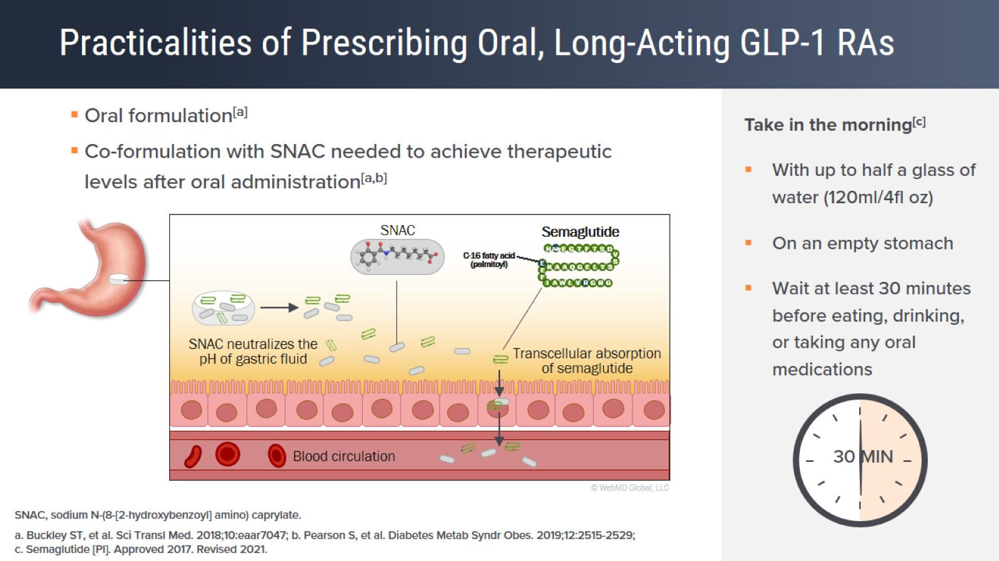
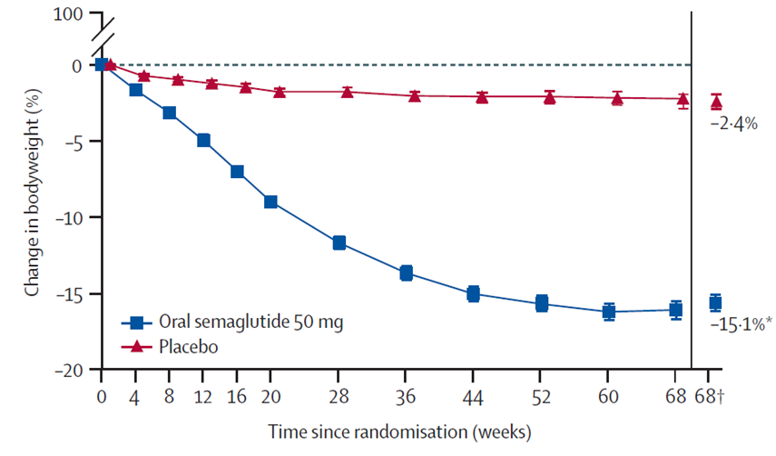
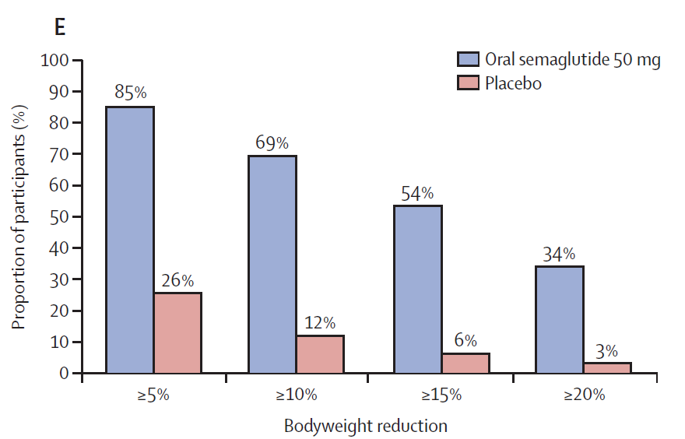
Oral semaglutide 50 mg (OASIS-1)
Knop FK et al. Lancet 402: 705–19, 2023

Slide 11
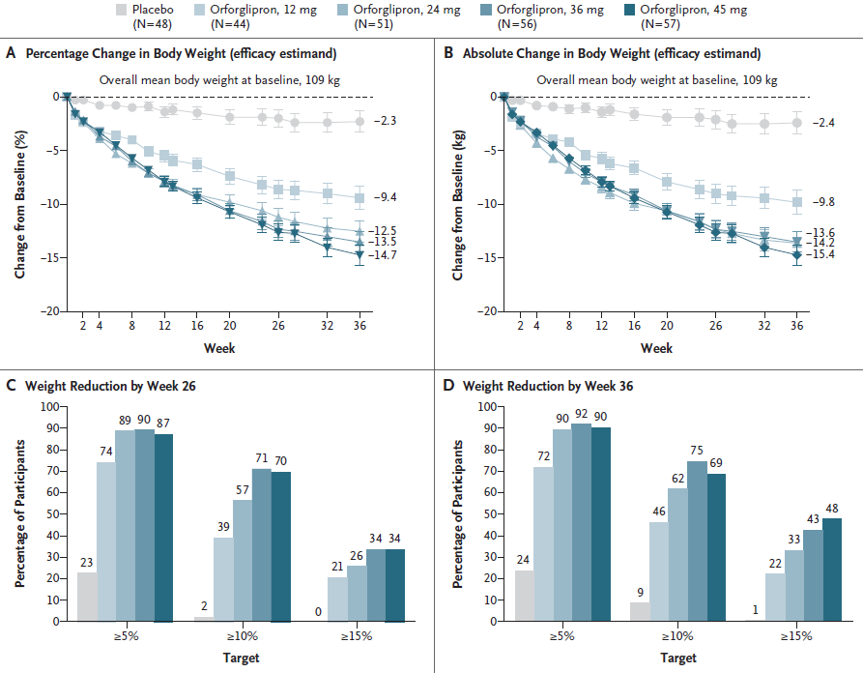
Weight Loss and Changes in CV Risk Factors With Orforglipron Phase 2 Trial
Orforglipron: a oral non-peptide GLP-1RA
Studio di fase 2
Orforglipron was administered once daily by oral capsule in the morning without meal-timing restrictions
Wharton S et al. N Engl J Med 389:877-88, 2023

Slide 12
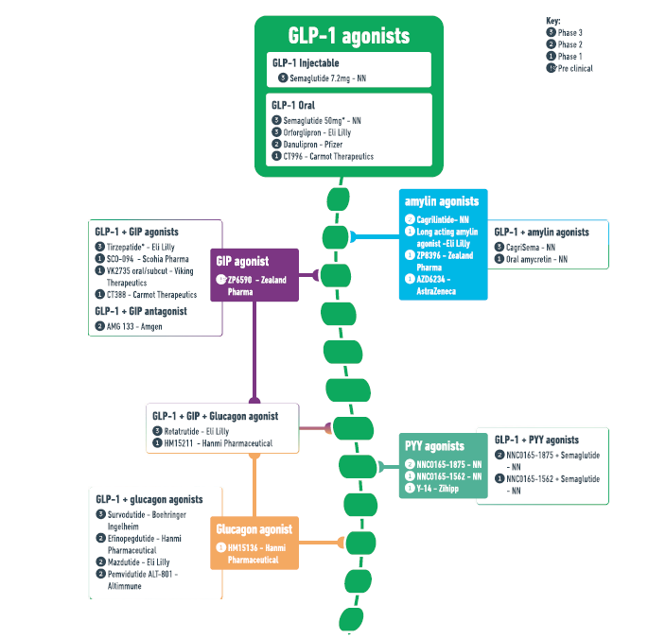
Glucagon-like peptide-1 as the backbone of the pipeline for gut hormone-based obesity treatments
Melson, E et al. Int J Obes (2024)

Slide 13
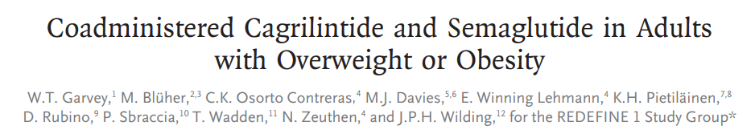
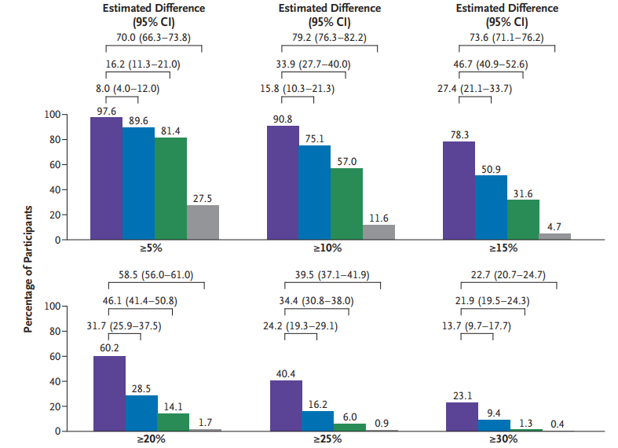
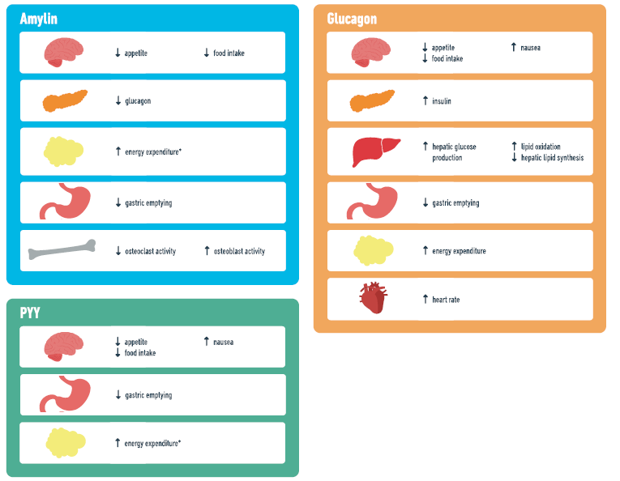
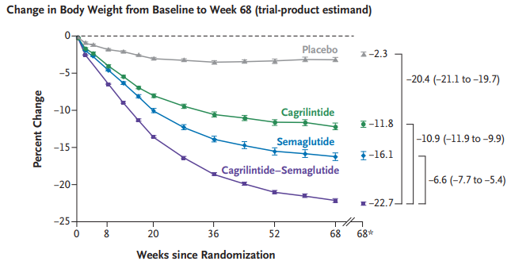
GLP-1/AMILINA
Semaglutide/Cagrilintide
(CAGRISEMA)
Studio di fase 3a
Garvey WT et al. N Engl J Med 2025;393:635-47

Slide 14


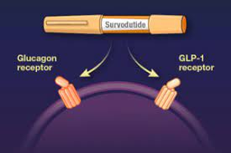
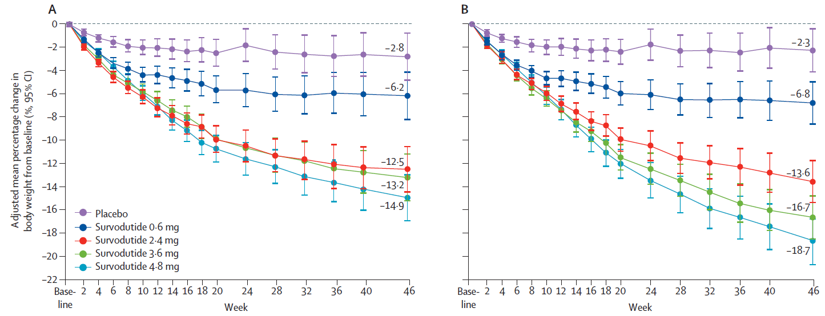
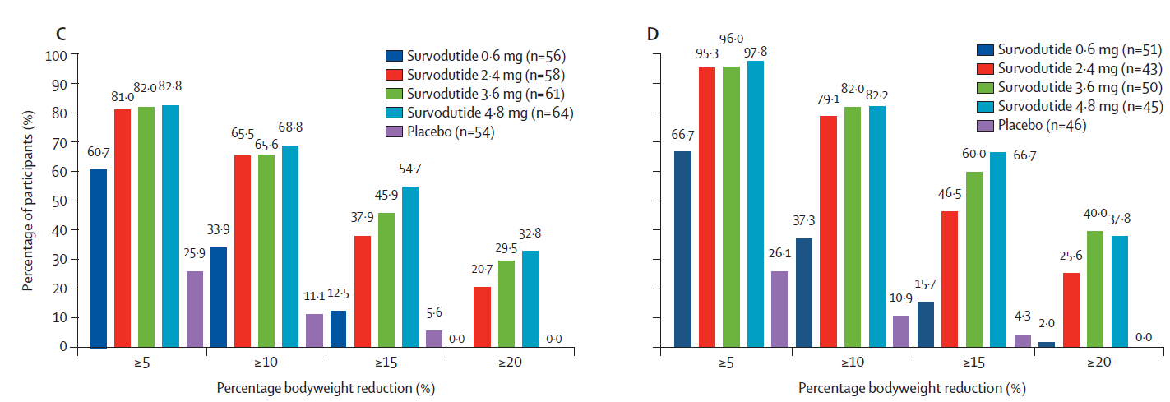
+
=
GLP-1/Glucagone (SURVODUTIDE)
Glucagon and GLP-1 receptor dual agonist SURVODUTIDE for obesity:
a dose-finding phase 2 trial
le Roux, CW et al. Lancet Diabetes Endocrinol 12: 162–73, 2024

Slide 15
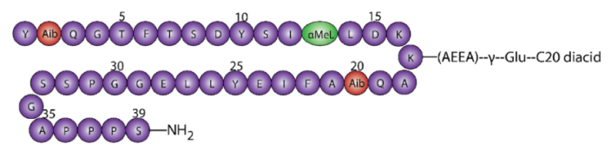
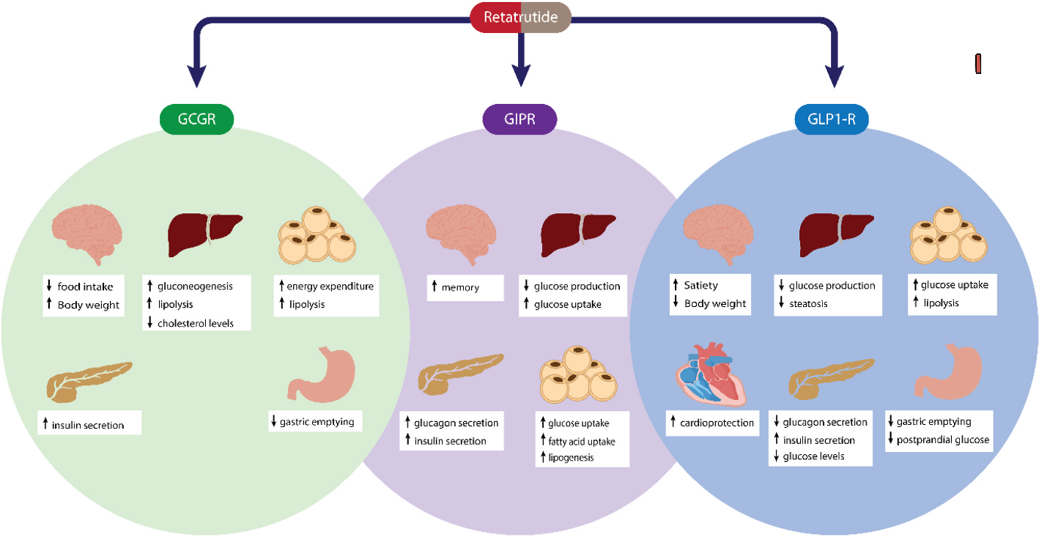
Retatrutide: the power of three…

Slide 16
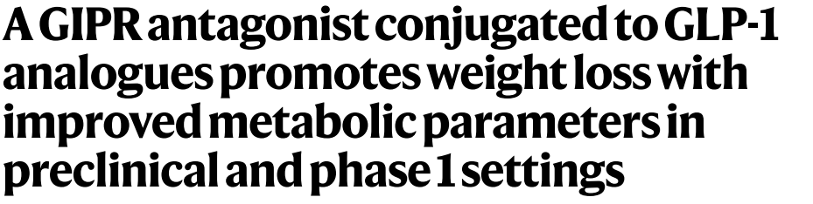
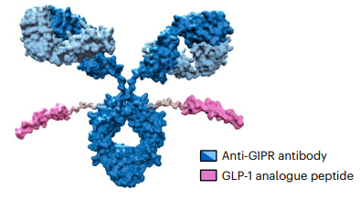
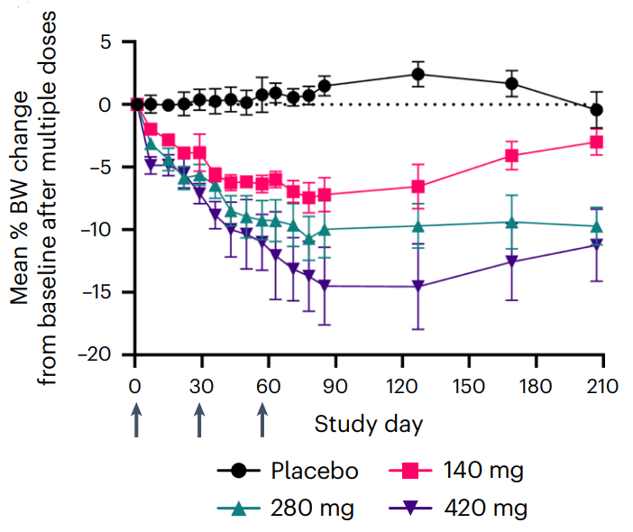
GLP-1/GIP antagonism (MariTide)
SOMMINISTRAZIONE MENSILE
AMG133
monoclonal antibody that was designed to antagonise the GIP receptor and is also linked to two modified GLP-1 peptides that activate the GLP-1 receptor
subcutaneous, every 4 weeks
Arrows indicate when the investigational product was administered
Nat Metab. 2024 Feb;6(2):290-303

Slide 17
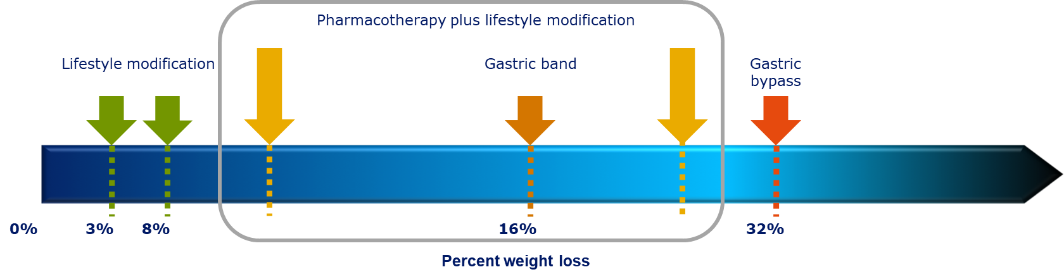
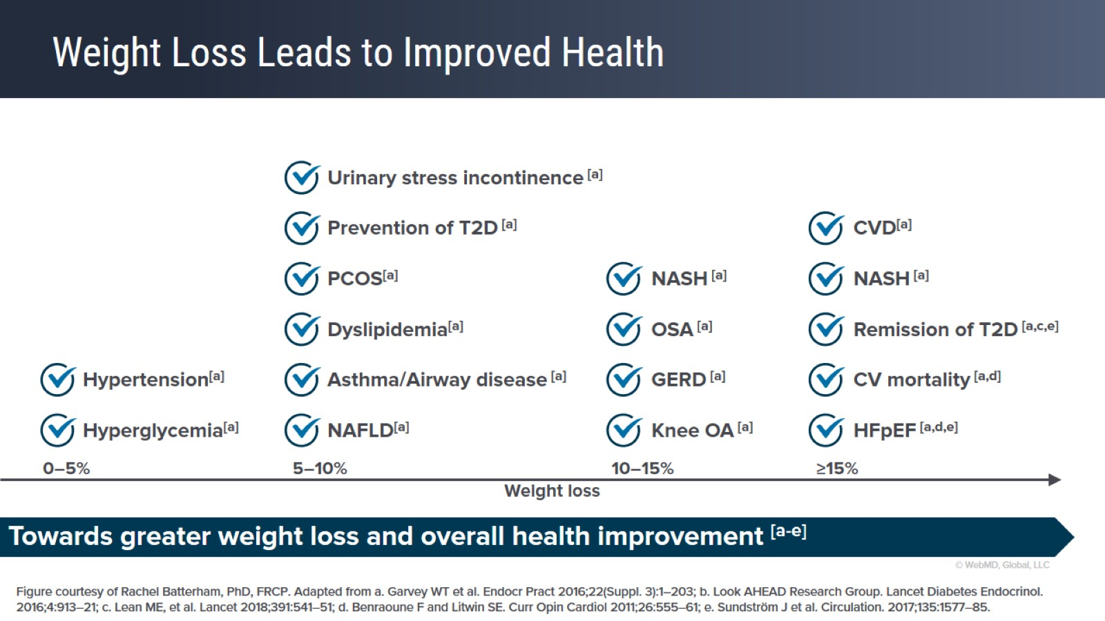
Greater weight loss
…leads to improved health!

Slide 18
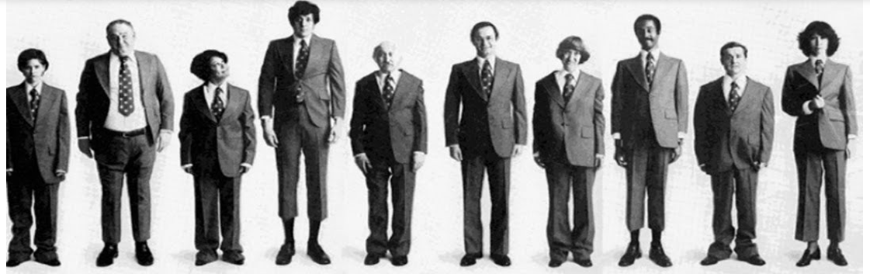
One size does NOT fit all!
Possibilità di personalizzazione sulla base di:
modalità somministrazione
target di perdita di peso
comorbidità presenti
necessità di terapie di combinazione
APPROCCIO INDIVIDUALIZZATO E ADATTABILE NEL TEMPO

Slide 19
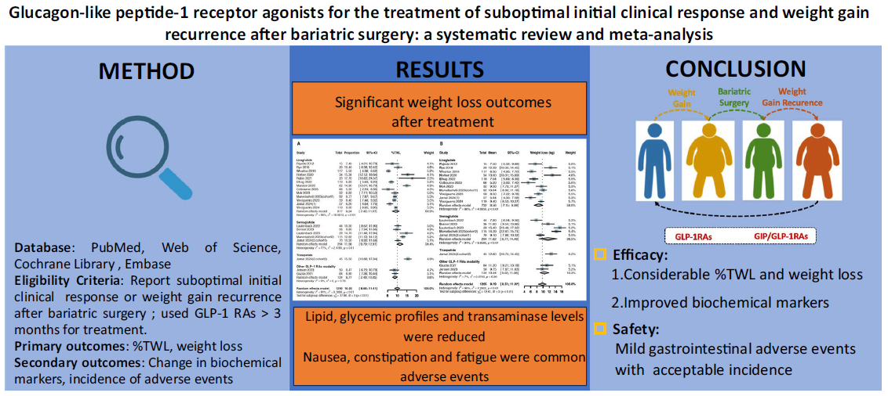
Terapia farmacologica in caso di “insufficient weight loss” o “weight regain”
Nie Y et al. Obes Surg. 2025 Mar;35(3):808-822

Slide 20
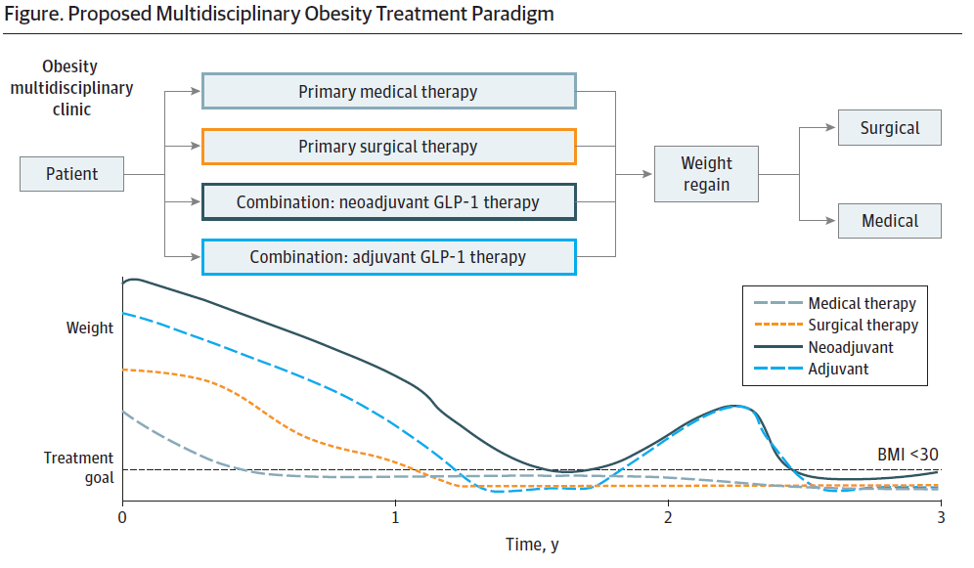
Samuels JM et al. JAMA Surg. 2024 Aug 1;159(8):841-842

Slide 21
